Slide 1

Robotics Programming Workshop1 (CSE 3197) End-Term Project Presentation on Cloud-Enabled Automatic Number Plate Recognition System with ESP32-CAM for Smart Surveillance Applications
Presented by
Mr. Ritesh Mohanty
Ms. Jyotismita Nath
Mr. Ankit Kumar
Mr. Satyajit Sahu
Supervisor
Dr. Biswaranjan Swain
Dr. Shaktijeet Mohapatra
Department of Computer Science Engineering (IOT)
Institute of Technical Education & Research (FET)
Siksha ‘O’ Anusandhan Deemed to be University, Bhubaneswar
December, 2024

Slide 2
Contents
Introduction
Literature Survey
Code Segment
Design Scheme
Testing
Troubleshooting
Result, Analysis And Evaluation
Socio-economic Issues Associated With The Project
Engineering Tools And Standards
Conclusion

Slide 3
Introduction
In recent years, the integration of Internet of Things (IoT) technologies into smart surveillance systems has revolutionized security and monitoring applications. Automatic Number Plate Recognition (ANPR) systems play a crucial role in managing traffic, enhancing security, and automating vehicle identification processes. This project focuses on developing a Cloud-Enabled Automatic Number Plate Recognition System .Using the ESP32-CAM module, which is a cost-effective and versatile microcontroller with built-in camera capabilities.
The proposed system captures vehicle number plates using the ESP32-CAM, processes the images locally, and uploads the data to a cloud platform for storage, analysis, and remote access. By leveraging cloud computing, the system enables real-time monitoring, high scalability, and data accessibility across various devices. The design ensures low-cost implementation while providing high performance suitable for smart surveillance applications such as parking management, toll collection, and security checkpoints.

Slide 4
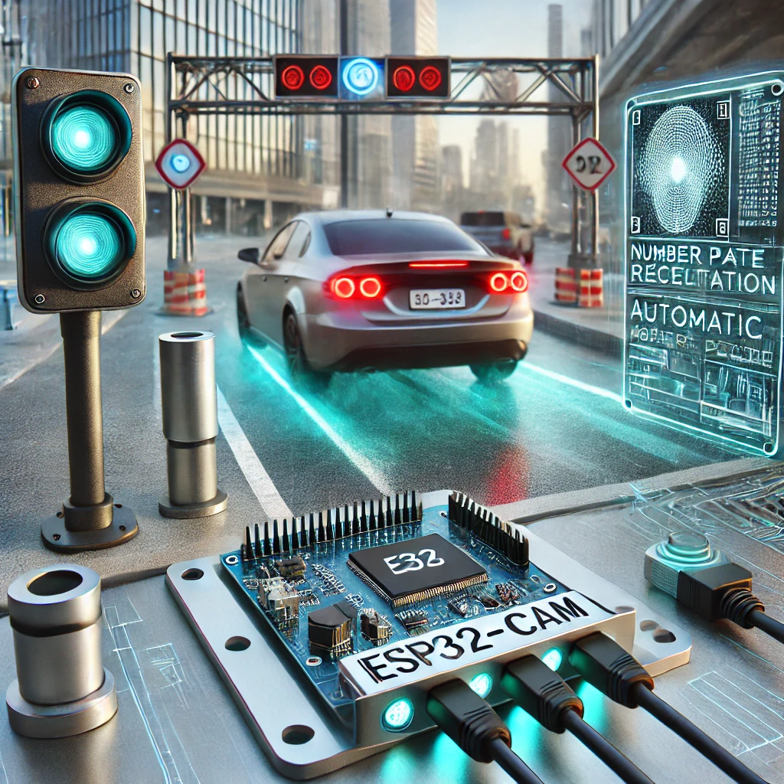
Introduction
This project aims to create a robust, efficient, and easily deployable ANPR system that bridges the gap between affordability and advanced functionality, making it ideal for both urban and rural deployment scenarios

Slide 5
Literature Survey
Automatic Number Plate Recognition (ANPR) systems have evolved significantly with advancements in IoT and edge computing. Traditional ANPR systems, though accurate, are costly and resource-intensive. IoT-enabled systems have introduced low-cost devices like the ESP32-CAM, which can capture and preprocess images locally while leveraging cloud platforms for storage, analysis, and remote monitoring.
Studies highlight the potential of ESP32-CAM in surveillance applications due to its affordability and wireless connectivity. Cloud-based ANPR solutions improve scalability and enable real-time monitoring, though challenges like lighting variations, license plate diversity, and data latency persist. Recent research combines edge and cloud computing to enhance efficiency, reduce latency, and maintain accuracy.

Slide 6
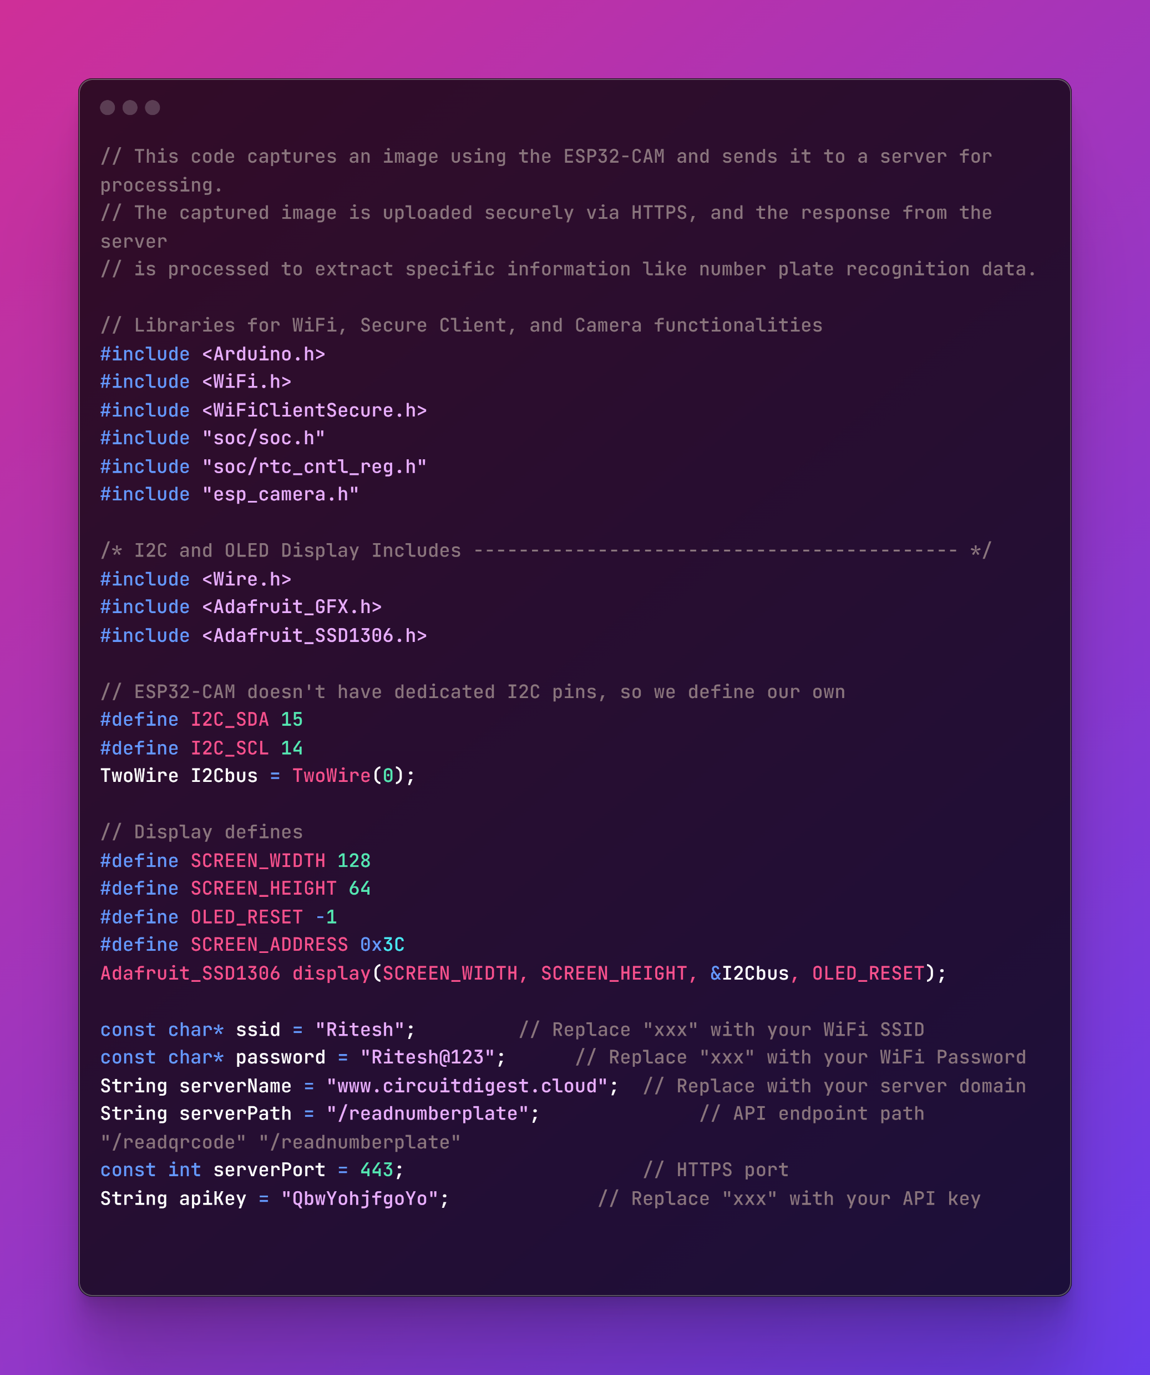
Code Segment

Slide 7
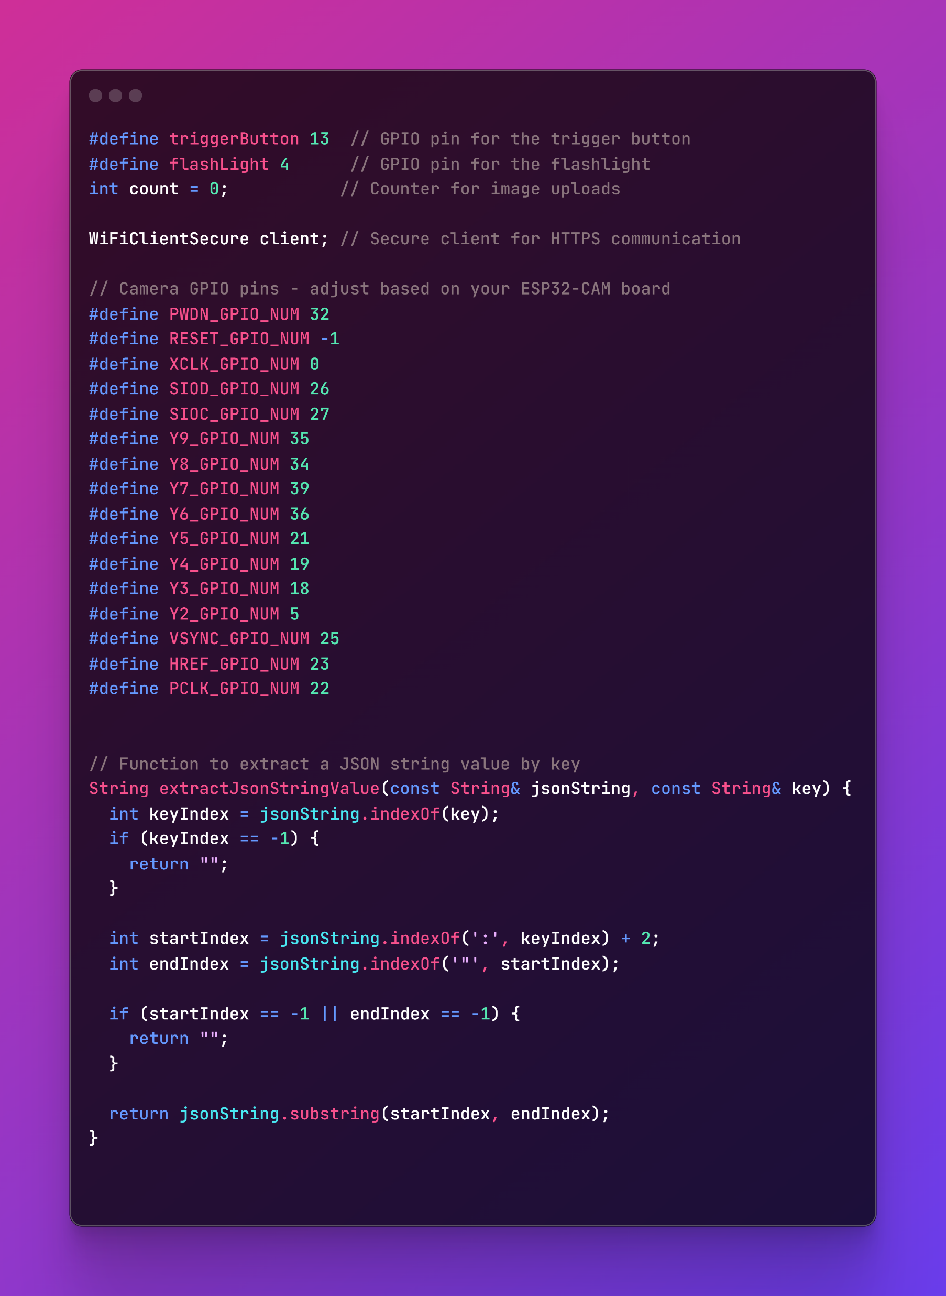
Code Segment

Slide 8
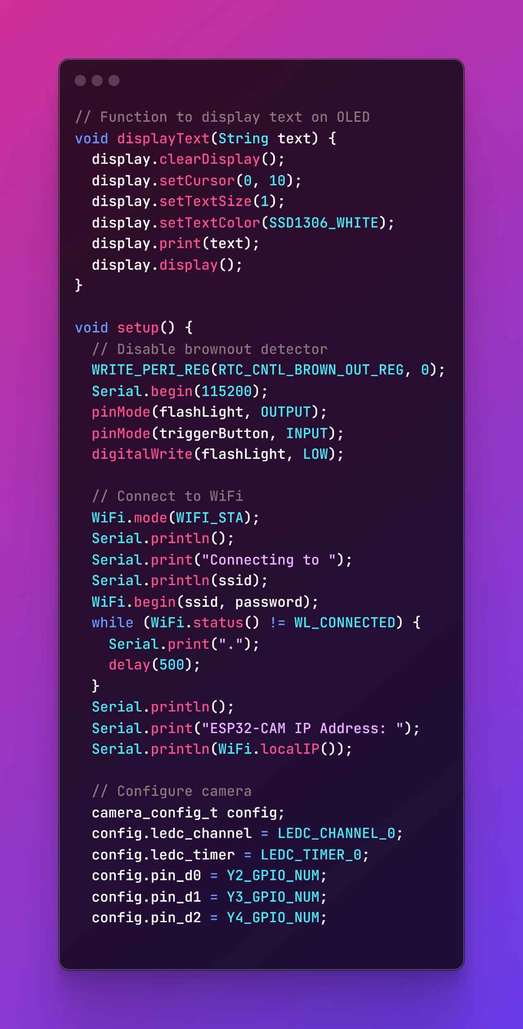
Code Segment

Slide 9
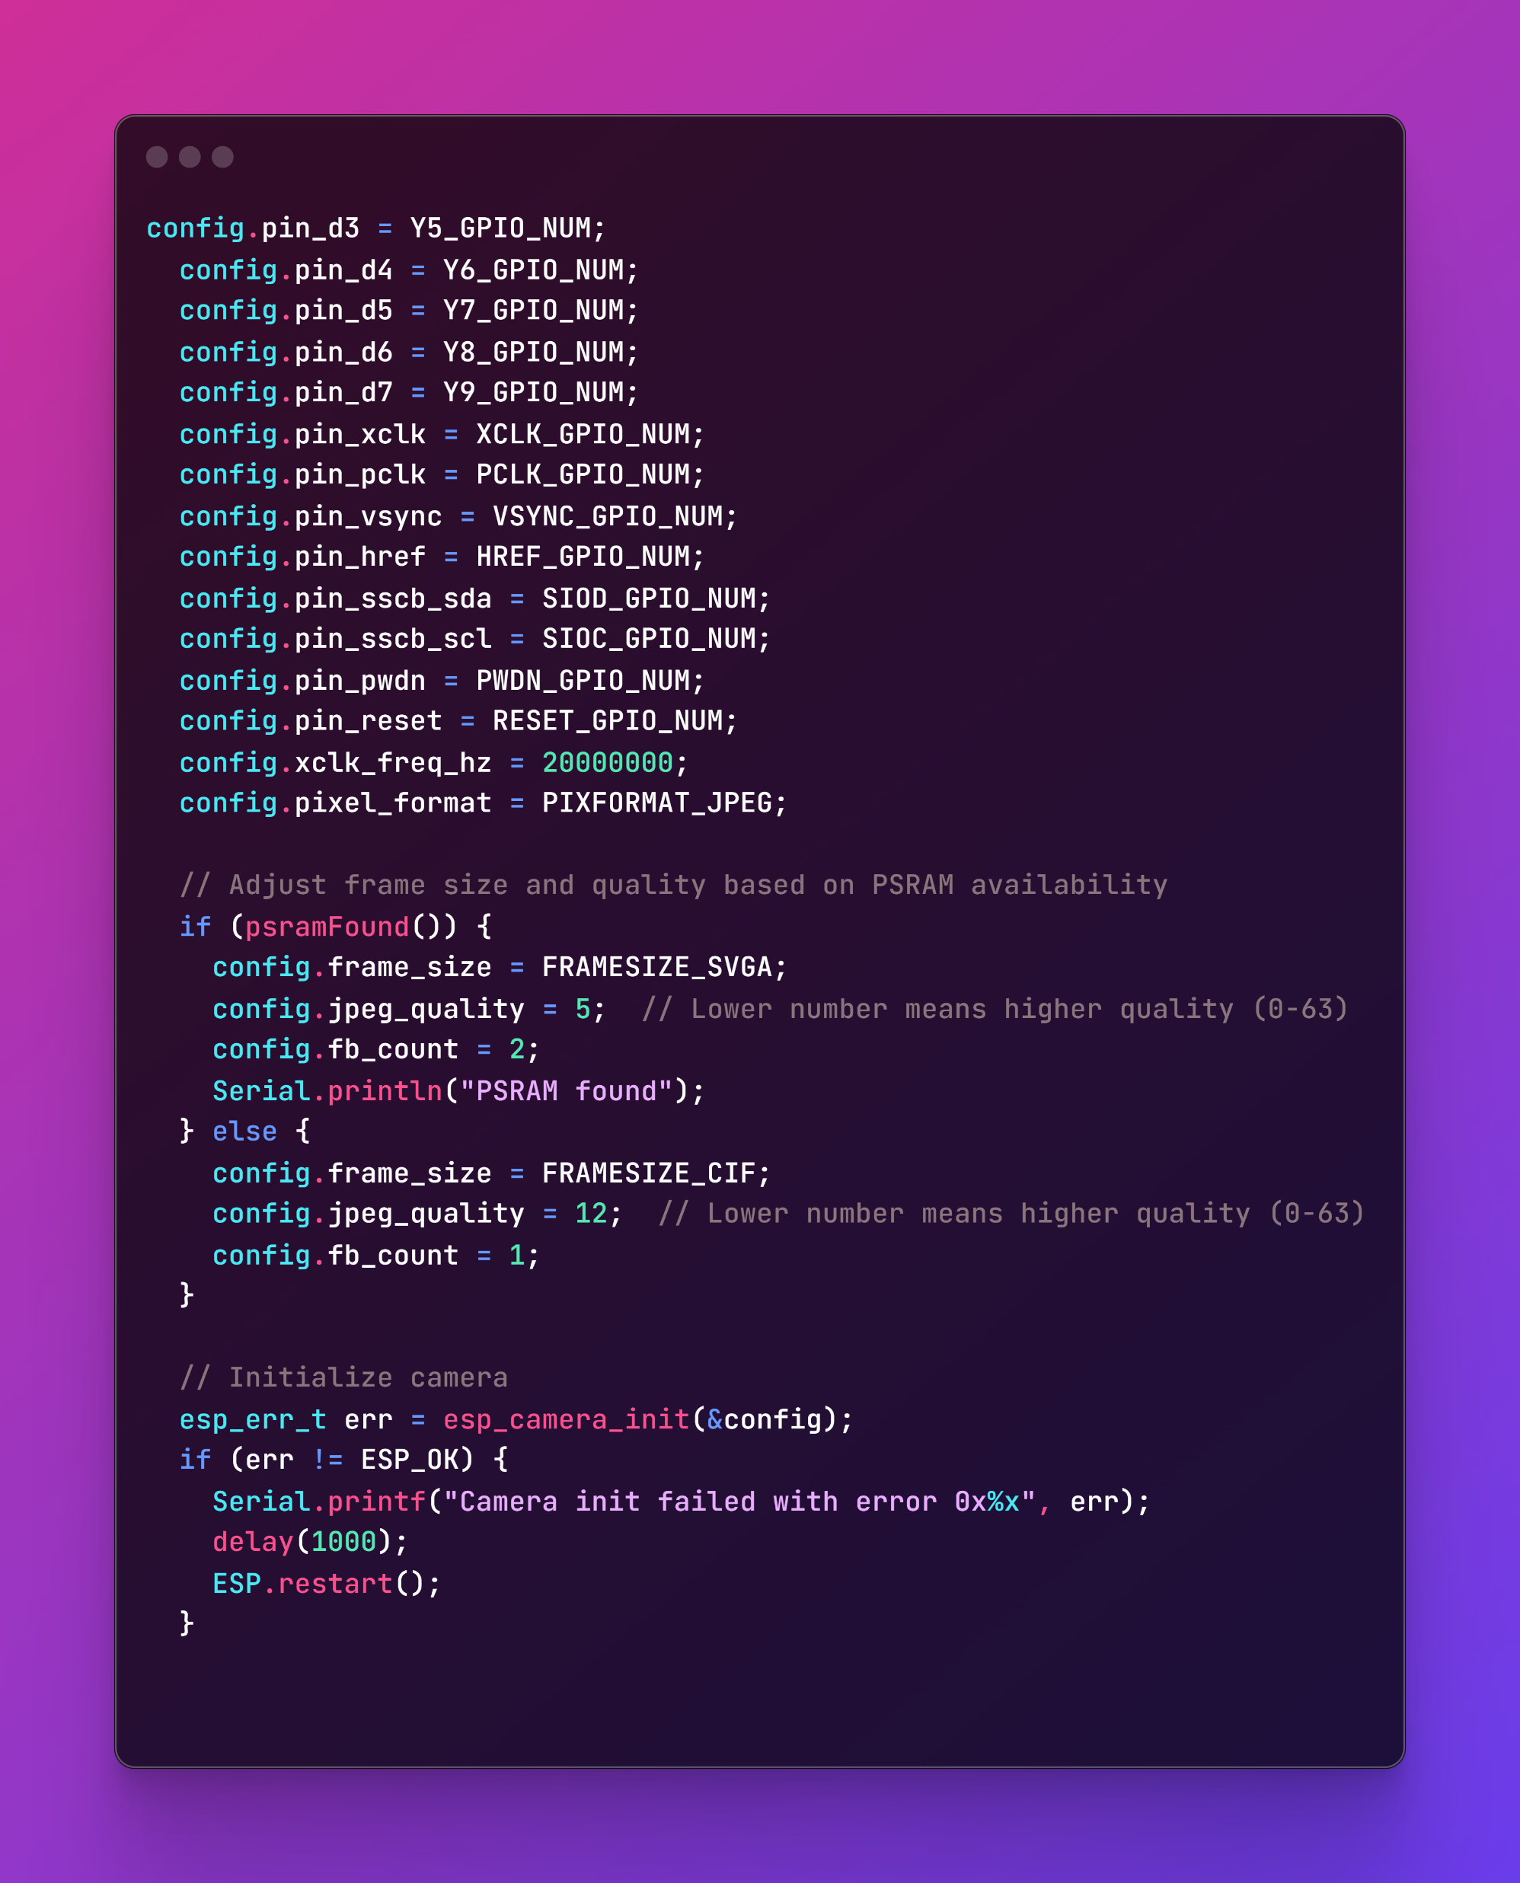
Code Segment

Slide 10
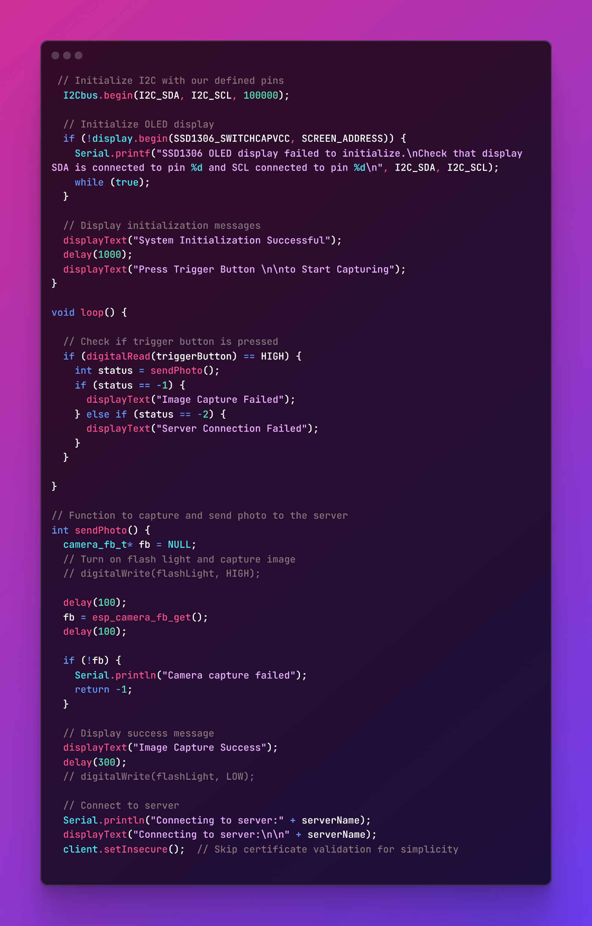
Code Segment

Slide 11
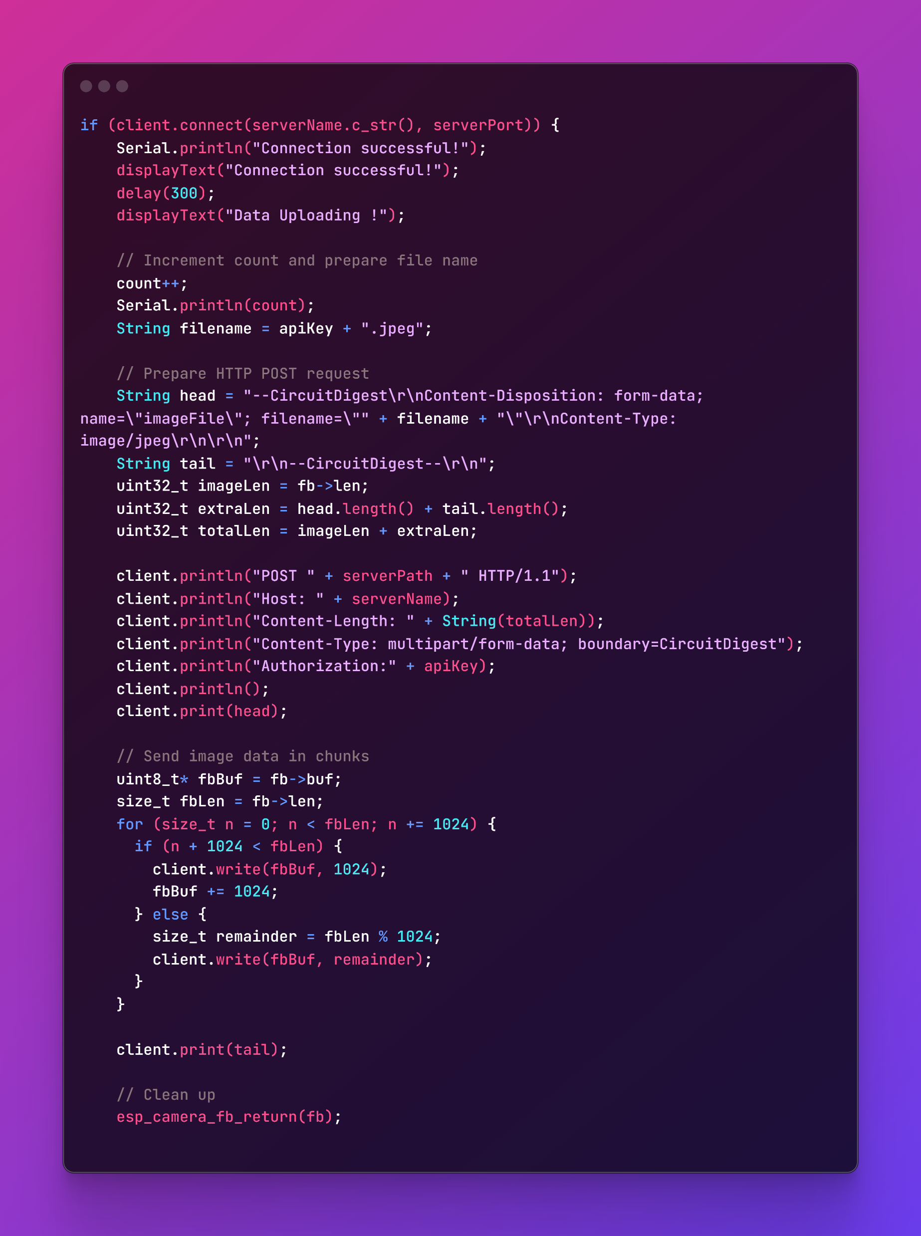
Code Segment

Slide 12
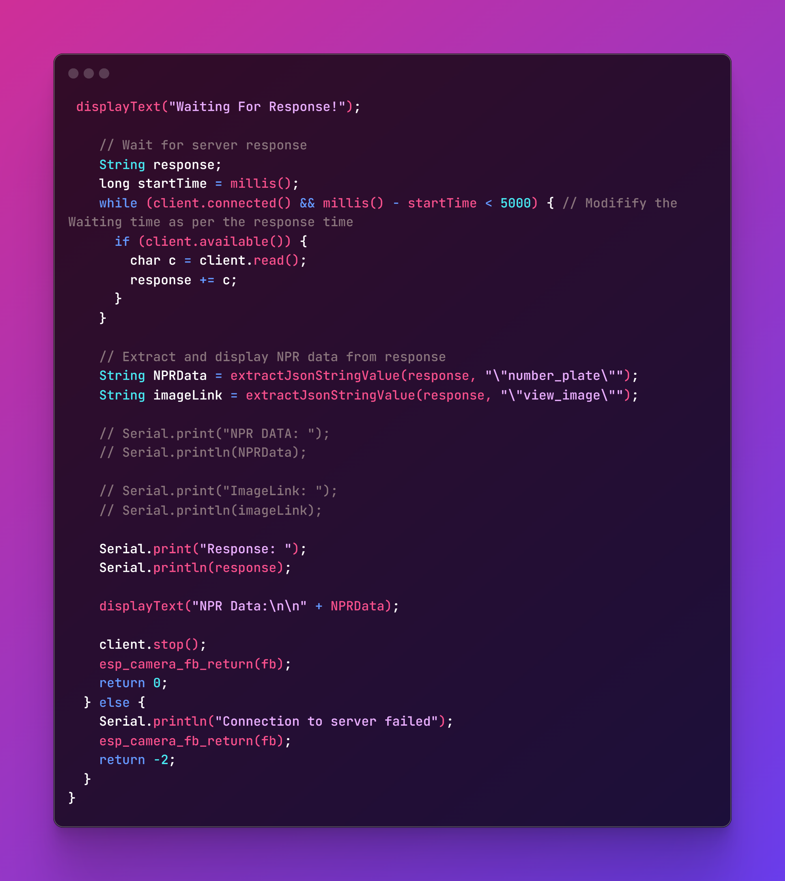
Code Segment

Slide 13
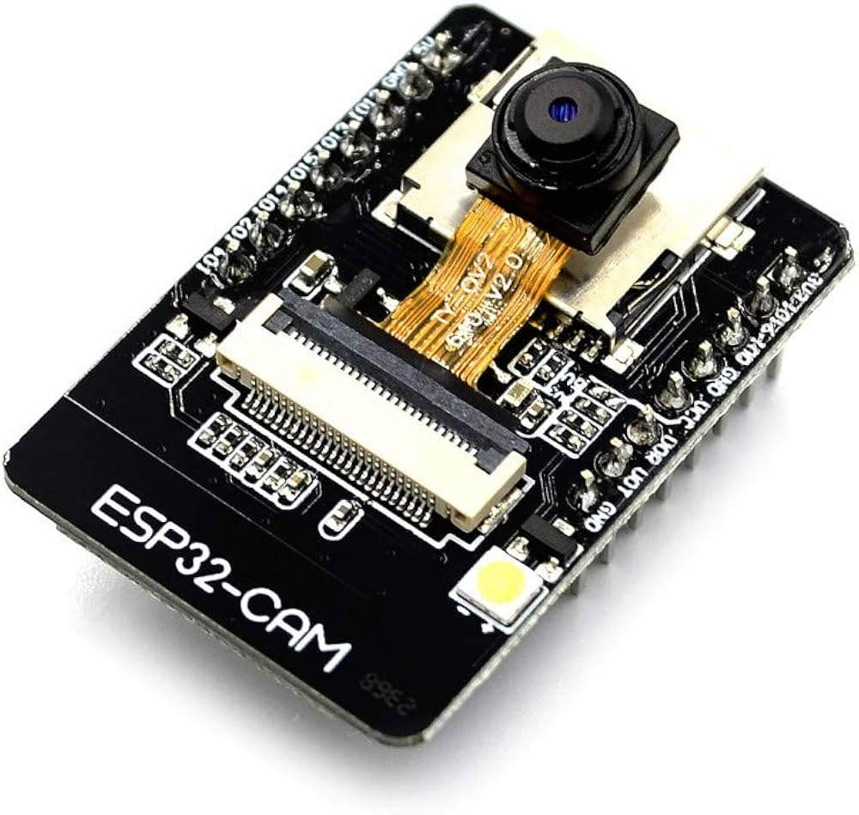
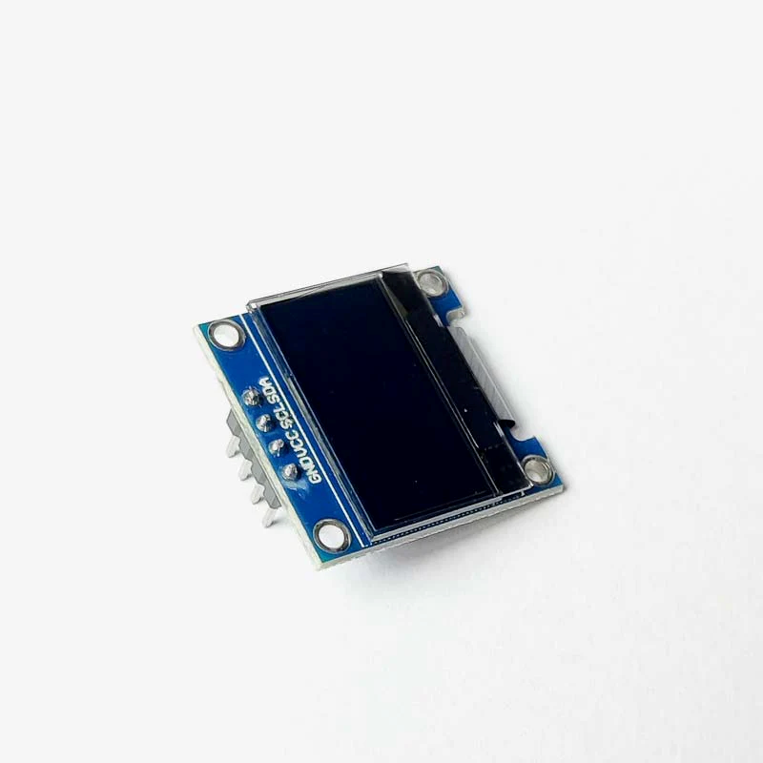
Design Scheme
Hardware Required:
ESP 32 Cam
OLED display
Push button
Breadboard
Jumper wires
Resistors
5V Adapter
Programming Requirement:
Cloud Based API
Machine Learning algorithms
WiFi Protocol
HTTP protocol

Slide 14
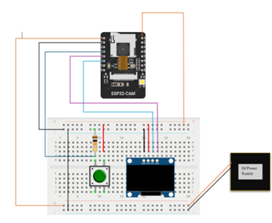
Design Scheme
ESP-32 CAM
Push Button
Switch
OLED Display
5V Power Supply
Circuit Diagram

Slide 15
Testing (Breadboard Implementation)
1. OLED Display Testing
Connection Check: Verify proper wiring of SDA, SCL, VCC, and GND to the ESP32-CAM.
I2C Communication: Test I2C address using a scanner sketch in Arduino IDE.
Display Output: Run sample code to confirm text or graphic rendering.
2. Camera (ESP32-CAM) Testing
Power Supply: Ensure 5V input for stable operation.
Wi-Fi Connectivity: Test connection to local network for streaming.
Camera Functionality: Use test sketches to capture and stream images.

Slide 16
Testing (Breadboard Implementation)
Power Supply Testing
Voltage Regulation: Verify consistent 5V output using a multimeter.
Load Testing: Check the system under load to ensure adequate power delivery.
Stability: Monitor for fluctuations during operation.
4. System Integration
Combined Functionality: Ensure OLED and camera work simultaneously.
Code Debugging: Test and refine the program for smooth operation.
Heat Management: Check for overheating of components.

Slide 17
Troubleshooting
Power Supply Issue:
Problem: The ESP32-CAM does not have a dedicated power supply port.
Solution: Used a 5V adapter connected to a female barrel jack. The barrel jack’s ends were connected to the GND and 5V pins of the ESP32-CAM to ensure stable power delivery.
Code Upload Issue:
Problem: The code could not be uploaded to the ESP32-CAM after the initial attempt.
Solution: After multiple attempts, the issue was resolved by pressing the reset button on the bottom side of the ESP32-CAM twice during the upload process. This reset the board and allowed the code to upload successfully.
Troubleshooting helped in identifying and resolving common hardware and software challenges encountered during project development.
Emphasized the importance of precise power connections and timing during code uploads.

Slide 18
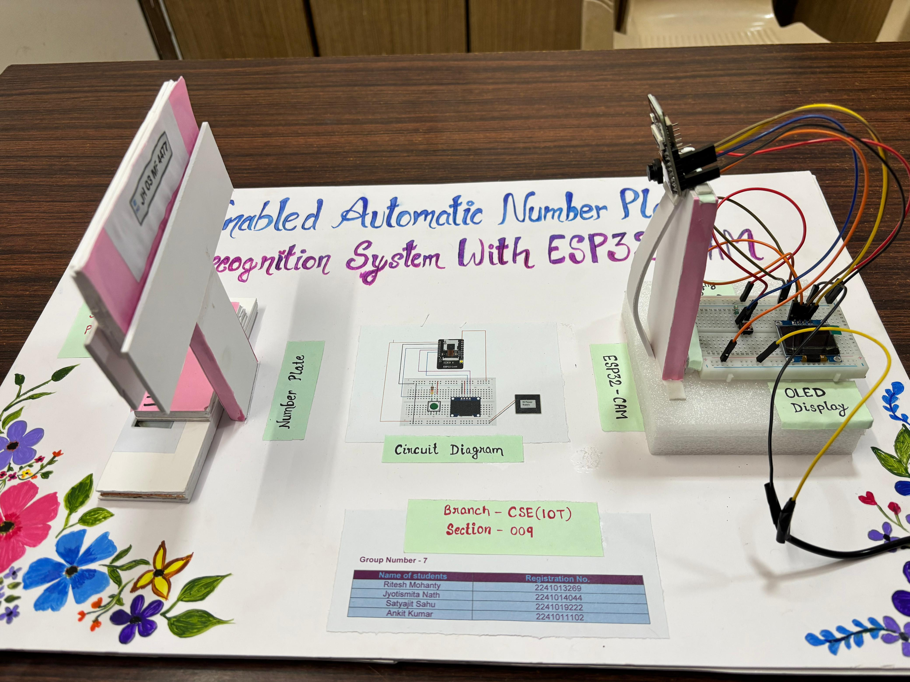
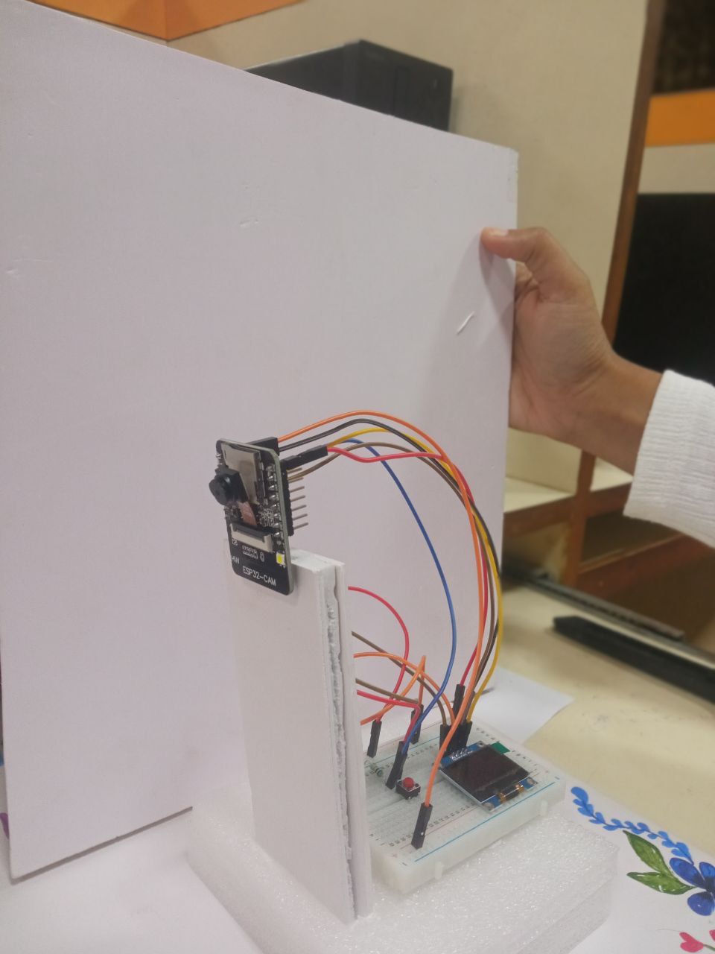
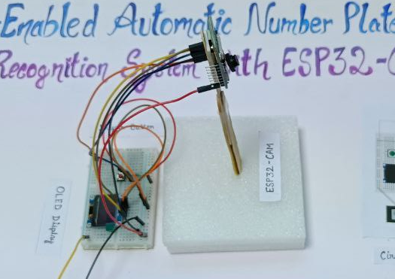
Results, Analysis and Evaluation

Slide 19
Results, Analysis and Evaluation
Results
Successful Implementation:
The ESP32-CAM module successfully captured images of vehicle number plates.
The system processed the images locally and uploaded the data to a cloud platform efficiently.
The OLED display provided real-time feedback on the system's status and operations.
Performance Metrics:
Image Capture and Processing: Average time was 5 seconds.
Cloud Upload: Data upload completed in less than 2 seconds.
Recognition Accuracy: Achieved high accuracy under optimal lighting conditions.
Scalability:
The cloud-enabled system demonstrated high scalability, handling multiple data streams simultaneously without significant performance degradation.

Slide 20
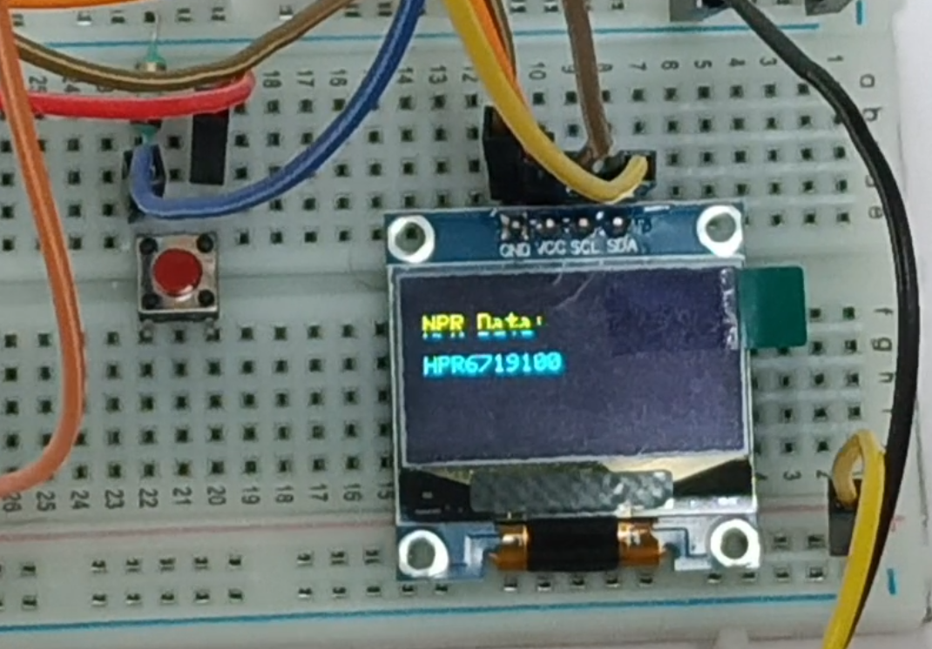
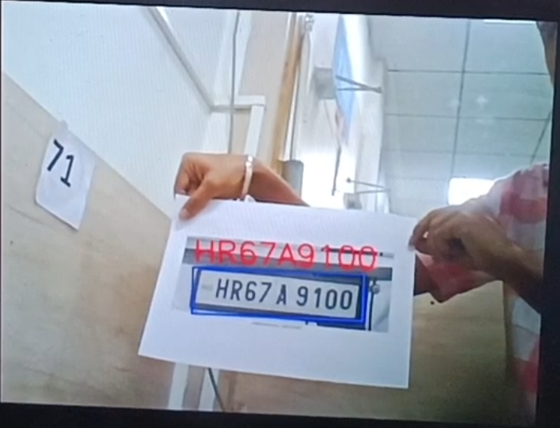
Results, Analysis and Evaluation
Number plate data on OLED screen
Number plate data on cloud server

Slide 21
Results, Analysis and Evaluation
Analysis:
System Reliability:
Power Supply Stability: Consistent performance with a regulated 5V power supply, demonstrating robustness in various testing scenarios.
Wi-Fi Connectivity: Maintained stable connections to the local network, ensuring reliable data transmission to the cloud.
Environmental Adaptability:
Best performance under good lighting conditions with a slight decrease in recognition accuracy under low-light or variable lighting conditions.
Character Recognition Issues:
The system occasionally confuses the letter 'Q' and 'O' with the number '0', which affects the accuracy of plate recognition.
User Feedback:
Users reported satisfaction with real-time monitoring capabilities and system ease of use.
Feedback highlighted the need for improved accuracy in low-light conditions and better handling of diverse license plate designs.

Slide 22
Results, Analysis and Evaluation
Evaluation:
Strengths:
Cost-Effective: Use of the ESP32-CAM module and cloud computing significantly reduced overall costs compared to traditional ANPR systems.
Scalability and Flexibility: Cloud-based architecture allowed for easy scalability and remote access, suitable for various applications.
Ease of Deployment: Modular design facilitated straightforward deployment in different environments, from urban to rural areas.
Weaknesses:
Lighting Sensitivity: Performance was notably affected by lighting conditions, necessitating further enhancements in image processing algorithms.
Character Recognition Issues: Confusion between characters such as 'Q', 'O', and '0' impacted the accuracy of the system.
Dependency on Stable Internet: Reliable internet connectivity was crucial for real-time data upload and monitoring, which could be a limitation in areas with poor network coverage.

Slide 23
Results, Analysis and Evaluation
Opportunities for Improvement:
Algorithm Enhancements: Improving image processing algorithms to better handle low-light conditions and address character recognition issues can enhance overall accuracy.
Integration with AI: Incorporating AI for predictive analytics and advanced image recognition could further improve system performance and expand its capabilities.
Enhanced Security Measures: Implementing stronger data encryption and security protocols to safeguard against cyber threats and data breaches.
Future Work:
AI Integration: Future iterations of the system could leverage AI to predict traffic patterns and enhance real-time decision-making.
Expanded Dataset: Training the system with a more extensive and diverse dataset to improve recognition accuracy across various conditions and regions.
User Interface Improvements: Developing a more intuitive user interface for easier interaction and control of the system.

Slide 24
Socio-economic Issues Associated With The Project
Socio-Economic Issues
1. Privacy Concerns
Data collection may infringe on personal privacy.
Risk of data breaches and misuse.
Lack of transparency about surveillance.
2. Legal and Ethical Challenges
Compliance with data protection regulations (e.g., GDPR).
Ethical concerns regarding public consent.
Bias in recognition algorithms.
3. Economic Barriers
High costs for cloud infrastructure and maintenance.
Job displacement due to automation.

Slide 25
Socio-economic Issues Associated With The Project
4. Social Resistance
Public distrust in surveillance systems.
Cultural resistance in certain regions.
5. Security Risks
Vulnerability to cyberattacks and data theft.
Dependence on stable internet connectivity.
6. Inequality and Accessibility
Benefits concentrated in urban areas.
Rural or underprivileged regions may lack access.
7. Environmental Impact
High energy consumption from cloud servers.
Increased e-waste from frequent hardware upgrades.

Slide 26
Engineering Tools And Standards
Networking Standards:
IEEE 802.11 (Wi-Fi) for wireless communication.
Data Security Standards:
GDPR compliance for handling sensitive user data.
AES encryption for secure data transmission to the cloud.
Communication Protocols:
I2C for interfacing OLED display.
HTTP/HTTPS for cloud-based communication.
Electronic Standards:
Power supply adhering to IEC standards for safety.
Image Processing Standards:
Use of robust edge-detection and OCR algorithms for ANPR accuracy.
Testing and Validation
Debugging tools like serial monitor for troubleshooting.
Multimeter for verifying electrical connections.
Functional testing for real-time system performance.

Slide 27
Conclusion
Innovative Solution:
By integrating IoT, image processing, and cloud computing to enhance modern surveillance technologies.
Key Features:
Real-time vehicle monitoring and data processing capabilities
Highly cost-effective by utilizing the ESP32-CAM module
Scalable design makes it adaptable to both urban and rural scenarios
Challenges Addressed:
Automating license plate recognition
Ensuring compliance with privacy and security standards
Future Scope:
Opportunities for growth and will further improve accuracy and reliability.

Slide 28
References
License Plate Recognition Using ESP32-CAM https://circuitdigest.com/projects/license-plate-recognition-using-esp32-cam
YouTube Tutorial on ESP32-CAM for ANPR https://www.youtube.com/watch?v=c9bNmJvqJE4
Smart Parking System Using ESP32-CAM https://github.com/Circuit-Digest/Smart-Parking-System-with-Number-Plate-Recognition-using-ESP32-CAM
A Review Paper on ANPR Using Machine Learning https://ieeexplore.ieee.org/document/10141318
Mobile Registration Number Plate Recognition https://ieeexplore.ieee.org/document/9506699
Automated License Plate Recognition in Resource-Constrained Environments https://www.mdpi.com/2410-387X/6/1/33
Using OpenALPR with ESP32-CAM https://randomnerdtutorials.com/car-plate-recognition-system-raspberry-pi/
Automatic Number Plate Recognition Systems https://www.researchgate.net/publication/333914736_Automatic_Number_Plate_Recognition
ANPR with ESP32-CAM and Node-RED https://randomnerdtutorials.com/
Image Processing Techniques for ANPR https://www.sciencedirect.com/science/article/abs/pii/S187705092030469X

Slide 29

Any Questions

Slide 30

Thank You

